Slide 3
clear property specifies on which sides of an element floating elements are not allowed to float.

Slide 4
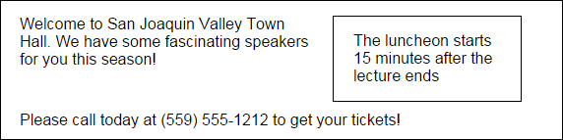

Slide 5
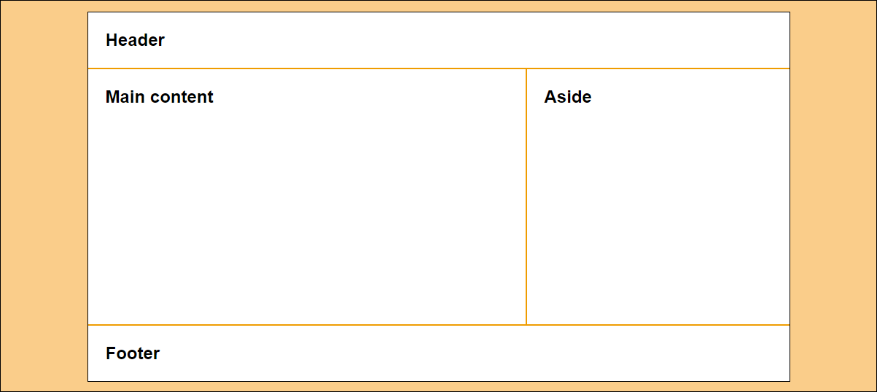

Slide 8
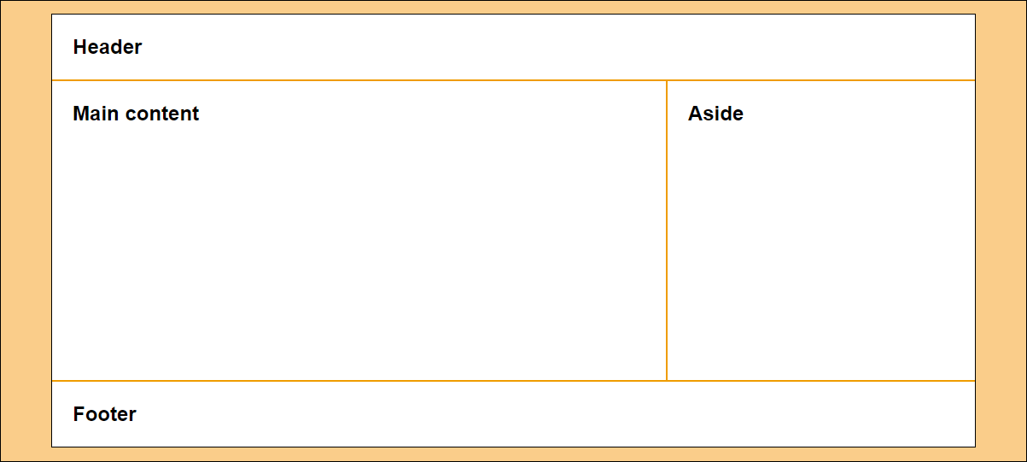

Slide 10
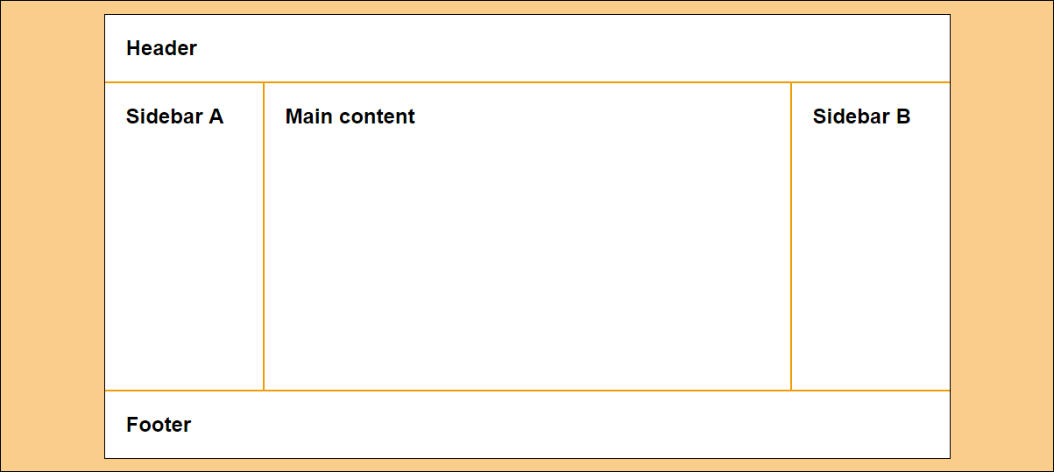

Slide 13


